Slide 1
Temperature Estimation by Color and Verification by Pyrometer
Task 1_5
17-01-2025

Slide 2
Introduction
The color and intensity of heated metal are used by traditional blacksmiths to assess temperature.
This job uses contemporary camera hardware and software to mimic the blacksmith's method.
To determine temperature, pictures taken with a regular camera are calibrated using a pyrometer.
The final objective is to verify this approach by contrasting it with measurements from high-end infrared cameras.

Slide 3
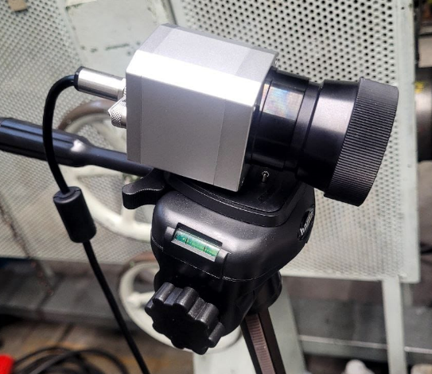
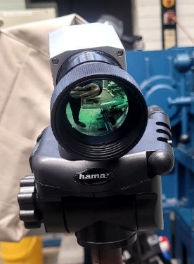
Objective
Develop a system for temperature estimation based on color and intensity.
Calibrate the camera using a pyrometer connected via USB.
Visualize temperature distribution by combining thermal data and images.
Compare results with a high-end IR camera for validation.
Fig 1:Thermal camera

Slide 4
Tools & Equipment Used
Camera: Standard camera connected to Raspberry Pi or similar.
Calibration Device: Spot pyrometer with USB connection.
Software: Python, OpenCV, and prebuilt Python-to-Robot communication modules.
Hardware: Inductive heating equipment for controlled temperature variation.

Slide 5
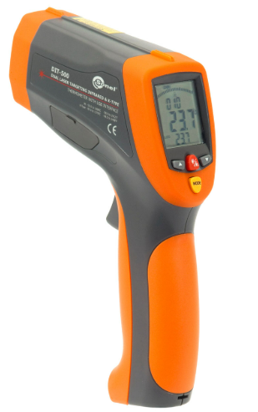
Methodology
SETUP: Mount the camera near the inductive heating equipment.
Calibration: Use the pyrometer for temperature correlation.
Due to technical issues instead of pyrometer we used thermal camera instead of it.

Slide 6
Methodology
Visualization: Capture thermal images and combine them with real-time photos using the codes that has been dumped.
Comparison:Validate data with high-end IR camera readings.
Based on the input code given, it takes the colors and give its temperature readings on the surfface.

Slide 7
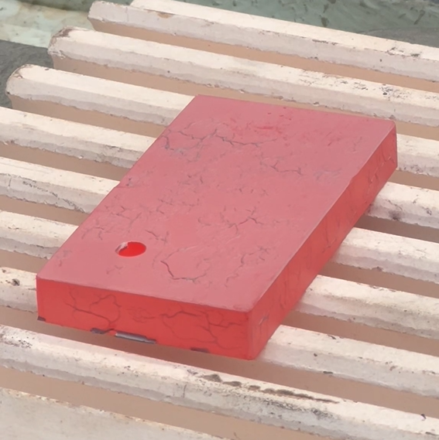
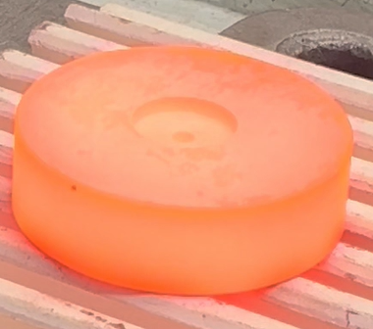
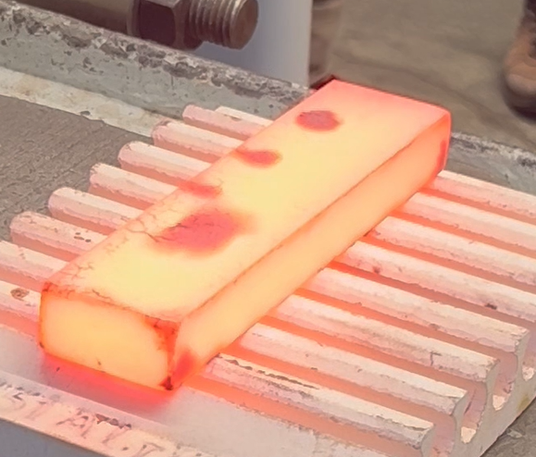
Workpiece
Fig 2 : Copper
Fig 3: Stainless Steel
Fig 4: Steel

Slide 8
Codes
Code 1:
Code 2:

Slide 9
Conclusion
Leveraging traditional methods with modern technology provides cost-effective solutions.
Pyrometer calibration ensures accuracy and reliability.
Comparison with advanced tools highlights areas for improvement and innovation.

